Slide 1
How to present a Research Paper
CSE 300: Technical Writing & Presentation

Slide 2

How to
Read
Write
Present
Review
Summarize
How to ___ a Research Paper?

Slide 3
How to
Read
Write
Present
Review
Summarize
How to ___ a Research Paper?

Slide 4


Slide 5


Impress the audience
Tell them all you know about a subject
Present every little detail of your work
Give the audience a sense of your idea / work
Make them want to read your paper
Feedback: To engage, excite, provoke them

Slide 6


The greatest ideas are worthless if you keep them to you
Good papers and talks are a fundamental part of research excellence
Write a paper, and give a talk, about any idea
Invest time
Learn skills
Practice

Slide 7

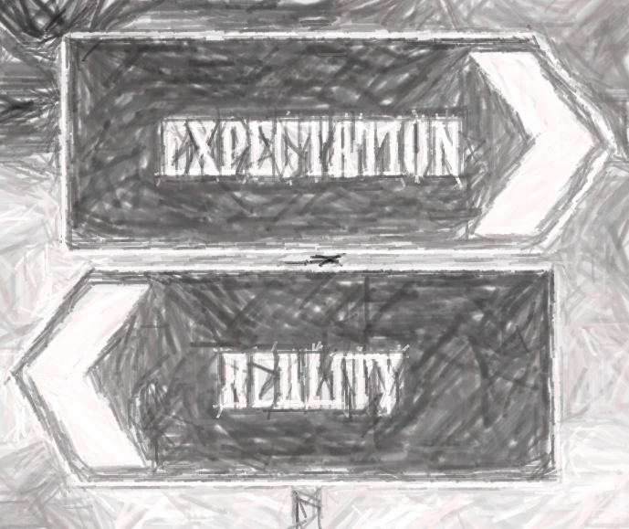


Have read all your earlier papers
Thoroughly understand all your notions and jargons
Are all agog to hear about the latest developments in your work
Are fresh, alert, and ready for action
Have never heard of you
Have heard of your jargons, but wish they hadn’t
Have just had lunch and are ready for a doze
WAKE THEM UP
Make them glad, they did

Slide 8
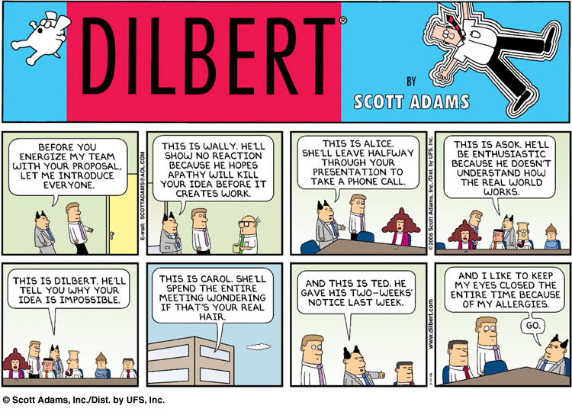

More seriously....
Who would be there?
Scientists expert in your field
Scientists not expert in your field
Students
Non experts

Slide 9
Remember:
They might be tired
They can read ☺
They are thinking “Why should I listen?”
Non-experts will tune off within 2 minutes
Experts after 5 minutes
More seriously....
Who would be there?
Scientists expert in your field
Scientists not expert in your field
Students
Non experts

Slide 10


Slide 11
What to put in
1. Motivation (20%)
2. Key Idea (80%)
3. There is no #3

Slide 12

Motivation:
Your Key Idea
Identify
Be Specific
Don’t leave your audience to
Organize
Ruthlessly prune material that is
figure it out for themselves.
irrelevant to this goal.
If the audience remembers only one thing from your talk, what should it be?
Notes:
If the audience remembers only one thing from your talk, what should it be?
ß You must identify a key idea. “What I did
this summer” is No Good.
ß Be specific. Don’t leave your audience to
figure it out for themselves.
ß Be absolutely specific. Say “If you
remember nothing else, remember this.”
ß Organise your talk around this specific
goal. Ruthlessly prune material that is
irrelevant to this goal.

Slide 13


Early motivation
Spoil the Punch line
Visuals
At the beginning, motivate your audience (use easy examples)
State your results early and in simple terms
Illustrate your idea with images and diagrams

Slide 14

Leave them with these thoughts…
I understood what the problem was and why it was important
I have an idea of what her solution was and how it was different/better than others
She knows the literature (i.e. quoted my work ☺) and we might collaborate on this aspect of her research

Slide 15


Your Main Weapon
Use Examples to
motivate the work
convey the basic intuition
illustrate the key Idea
show extreme cases
highlight shortcomings
Even when time is short, do not omit the examples

Slide 16

What to Leave Out
Outline of your talk
Apologies
Technical Details
conveys near zero information at the start
may put up an outline for orientation after your motivation
signposts at pause points
You absolutely must know the related work;
respond readily to questions
Acknowledge co-authors (title slide), and
pre-cursors (as you go along)
Do not disparage the opposition, rather write: X’s very interesting work does Y; I have extended it to do Z
will send your audience to sleep
Present specific aspects only
refer to the paper for the details
Have backup slides
“I didn’t have time to prepare this talk properly”
Related Work
“I don’t have time to tell you about this”
“I don’t feel qualified to address this audience

Slide 17
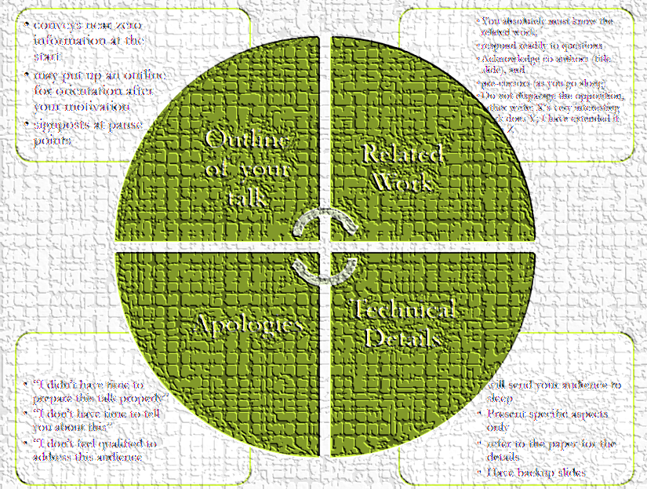
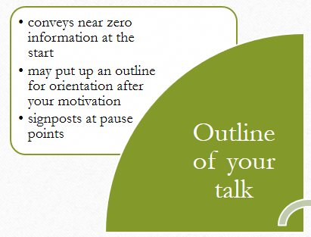
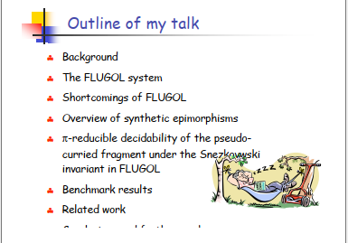
What to Leave Out

Slide 18
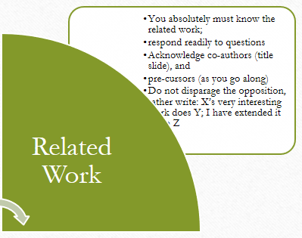
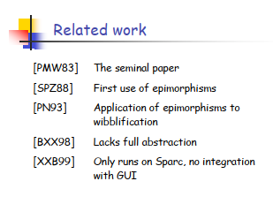
What to Leave Out

Slide 19
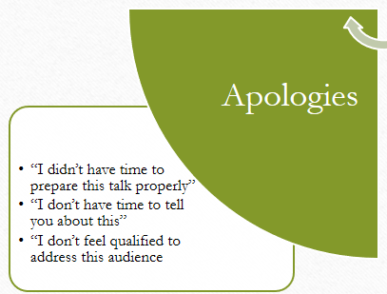
What to Leave Out

Slide 20
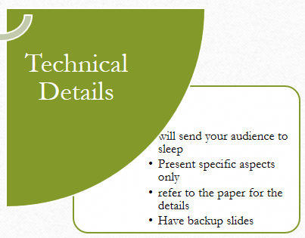
What to Leave Out

Slide 21
Actual Presentation
Prepare/polish the night before
Be Enthusiastic
Being seen and heard
Your talk absolutely must be fresh in your mind
If you do not seem excited by your idea, why should the audience be?
Point at the screen
Make eye contact;
identify a nodder, and speak to him or her

Slide 22
Actual Presentation
Questions
Q’s are not a problem
Rather, opportunity to connect with your audience
Specifically encourage questions during your talk
pause briefly now and then, ask for question
Be prepared to truncate your talk if you run out of time. Better to connect

Slide 23
Actual Presentation
The Jelly Effect
Inability to breathe
Inability to stand up (legs give way)
Inability to operate brain
How to Cope Up?
Script your first few sentences precisely
Move around a lot, use large gestures, wave your arms
(=> no brain required)
Go to the loo first

